Slide 1
Unit 2
VIRTUALISATION

Slide 2
UNIT – II VIRTUALIZATION AND COMMON STANDARDS IN CLOUD COMPUTING 06 Hours
Implementation Levels of Virtualization, Virtualization Structures/Tools and Mechanisms, Types of Hypervisors, Virtualization of CPU, Memory, and I/O Devices, Virtual Clusters and Resource Management,Virtualization for Data-Center Automation.
Common Standards: The Open Cloud Consortium, Open Virtualization Format, Standards for ApplicationDevelopers: Browsers (Ajax), Data (XML, JSON), Solution Stacks (LAMP and LAPP),Syndication (Atom, AtomPublishing Protocol, and RSS), Standards for Security.

Slide 3
Problem
Enterprise IT centers support many service applications
    Microsoft Exchange
    Oracle
    SAP
    Web servers
    Citrix
    …
Each service application demands its own environment
    Specific version of operating system
    Multiple processors and disks
    Specialized configurations
    …

Slide 4
Problem
Combining services on same server host is difficult (at best)
    Conflicting demands
    Incompatible loads
    …
Upgrading or commissioning a service is very difficult
Adding or upgrading hardware or OS is difficult
    Testing and refitting active service
    Complicated changeover tactics
    …
Load balancing is impossible
    Services tied to own systems
    Some underused, some overused

Slide 5
Ex:
Approx 20 difference services
Approx 20 server systems
    Approx. 80 processors
    > 100 gigabytes of RAM
    ~ 20 terabytes of disk storage
    Multiple operating systems

Slide 6
Solution — Virtualization
Decouple [OS, service] pair from hardware
Multiplex lightly-used services on common host hardware
Migrate services from host to host as needed
Introduce new [OS, service] pairs as needed
    Commissioning new services
    Testing upgrades of existing services
    Experimental usage
    …

Slide 7
Virtualisation - Basics
The ability to run multiple operating systems on a single physical system and share the underlying hardware resources
Virtualization can be viewed as utility computing, in which computer processing power is seen as a utility that clients can pay for only as needed. The usual goal of virtualization is to centralize administrative tasks while improving scalability and work loads
Defination
It is "a technique for hiding the physical characteristics of computing resources from the way in which other systems, applications, or end users interact with those resources.
This includes making a single physical resource (such as a server, an operating system, an application, or storage device) appear to function as multiple logical resources;
OR - it can include making multiple physical resources (such as storage devices or servers) appear as a single logical resource."

Slide 8
Virtualisation
Ex: Dividing your actual hard drive into different partitions.
A partition is the logical division of a hard disk drive to create, in effect, two or more separate hard drives C:, D:, E: etc..
Why virtualization?
The Reality:
  Most servers only use 5-15% of their capabilities on average, while consuming 60-90% of their peak power.
The Solution - Virtualization:
    Use one server to host multiple applications.
    Reduce energy consumption
    Reduce CO2 emissions
Running fewer, highly utilized servers frees up space and power. Less space and power is better for environment and saves money.

Slide 9
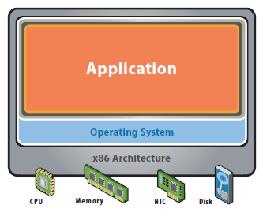
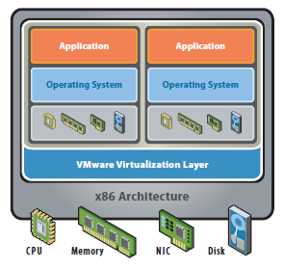
Virtualization
Tradition al Application Server
Virtual Server Model
Notes:
Single OS image per machine
Software and hardware
tightly coupled
Running multiple applications
on same machine
Underutilized resources
Inflexible and costly infrastructure

Slide 10
Virtual Machine
A virtual machine provides interface identical to underlying bare hardware
  I.e., all devices, interrupts, memory, page tables, etc.
Virtual Machine Operating System creates illusion of multiple processors
  Each capable of executing independently
  No sharing, except via network protocols
  Clusters and SMP can be simulated
Virtualization

Slide 11
Vitualisation Benefits
  Reduce Real Estate Needs
  Increase Up Time
  Reduce CO2 Emmissions, Power and Cooling Requirements
  Increase Flexibility
  Reduce Overall Costs
Virtual machines(VM) consolidates the workloads of under utilized servers.
VM helps in building secured computing platform.
VM provides illusion of hardware
VM simulates networks of independent computers
VM enables to share memory in multiprocessor archittecture
Notes:
More out of less
Pool common infrastructure resources and break the legacy “one application to one server” model with server consolidation.

Slide 12
History – CP67 / CMS
IBM Cambridge Scientific Center
Ran on IBM 360/67
    Alternative to TSS/360, which never sold very well
Replicated hardware in each “process”
    Virtual 360/67 processor
    Virtual disk(s), virtual console, printer, card reader, etc.
CMS: Cambridge Monitor System
    A single user, interactive operating system
Commercialized as VM370 in mid-1970s
Virtualization

Slide 13
History (continued)
“Hypervisor” systems – mid 1970s⇒mid 1990s
  Large mainframes (IBM, HP, etc.)
  Internet hosting services
  Virtual dedicated services
  …
Virtualization

Slide 14
Modern Virtualization Systems
VMware
  Workstation and Player
  Multiple versions of VMware Server
  Virtual appliances
Xen
  Public domain hypervisor
  Adaptive support in operating systems
  Emerging support in processor chips
    Intel, AMD
Macintosh Parallels
Virtualization

Slide 15
Definitions
Host Operating System:
  The operating system actually running on the hardware
  Together with virtualization layer, it simulates environment for …
Guest Operating System:
  The operating system running in the simulated environment
  I.e., the one we are trying to isolate
Virtualization

Slide 16
Virtual Machines (continued)
Virtual-machine concept provides complete protection of system resources
  Each virtual machine is isolated from all other virtual machines.
  However, limited sharing of resources
Virtual-machine system is a good vehicle for operating-systems research and development.
  System development is done on the virtual machine does not disrupt normal operation
  Multiple concurrent developers can work at same time
The virtual machine concept is difficult to implement due to the effort required to provide an exact duplicate to the simulated machine
Virtualization

Slide 17
Example – Page tables
Suppose guest OS has its own page tables Then virtualization layer must
  Copy those tables to its own
  Trap every reference or update to tables and simulate it
During page fault
  Virtualization layer must decide whether fault belongs to guest OS or self
  If guest OS, must simulate a page fault
Likewise, virtualization layer must trap and simulate every privileged instruction in machine!
Virtualization

Slide 18
Virtual Machines (continued)
Some hardware architectures or features are impossible to virtualize
  Certain registers or state not exposed
  Unusual devices and device control
  Clocks, time, and real-time behavior
Solution – drivers or tools in guest OS
  VMware Tools
  Xen configuration options in Linux build
Virtualization

Slide 19
Snapshots & Migration
Snapshot: freeze a copy of virtual machine
    Identify all pages in disk files, VM memory
    Use copy-on-write for any subsequent modifications
    To revert, throw away the copy-on-write pages
Migration: move a VM to another host
    Take snapshot (fast)
    Copy all pages of snapshot (not so fast)
    Copy modified pages (fast)
    Freeze virtual machine and copy VM memory
      Very fast, fractions of a second
Virtualization

Slide 20
Cloning
Simple clone:
    Freeze virtual machine
    Copy all files implementing it
    Use copy-on-write to speed up
Linked clone:
    Take snapshot
    Original and each clone is a copy-on-write version of snapshot
Virtualization

Slide 21
VMware – Modern Virtual Machine System
Founded 1998, Mendel Rosenblum et al.
    Research at Stanford University
VMware Workstation
    Separates Host OS from virtualization layer
    Host OS may be Windows, Linux, etc.
    Wide variety of Guest operating systems
    < $200
    VMware Player is a free, stripped-down version of VMware Workstation
Virtualization

Slide 22

VMware Architecture
Virtualization

Slide 23
VMware Server
Free version released in 2006
    http://www.vmware.com/products/server/
    Runs on any x86 server hardware and OS
    Windows Server and Linux Host OS’s
Partition a physical server into multiple virtual server machines
    Target market – IT centers providing multiple services
    Allows separate virtual servers to be separately configured for separate IT applications
      Provisioning
    Portability, replication, etc.
Virtualization

Slide 24
VMware Server ESX
Total decoupling between hardware and applications
High-end, high-performance IT applications
    Oracle, SQL Server, Microsoft Exchange server, SAP, Siebel, Lotus Notes, BEA WebLogic, Apache
Dynamically move running application to different hardware
    Maintenance, hardware replacement
    Provisioning new versions, etc.
Virtualization

Slide 25
Xen — Public Domain Virtualization Project
Cambridge University
  http://www.cl.cam.ac.uk/research/srg/netos/xen/
Philosophy – Adapt Guest OS to virtualization layer
  See configuration options of Suse Linux kernel
Virtualization

Slide 26
Must virtual machine be replica of host machine?
No, virtualization layer can simulate any architecture
    Typically used for debugging specialized systems
    Real-time systems, niche products, etc.
Guest architecture does not even have to be real hardware!
Virtualization

Slide 27

The Java Virtual Machine
Own idealized architecture
Stylized machine language
    Byte codes
Readily available interpreter
Virtualization

Slide 29
Types of Virtualisation
Hardware
  Server / OS / Devices ( peripheral devices like printer etc..)
  Desktop ( similar to above)
  Storage ( Memory, hard disk etc..)
  Network
Application software
Data

Slide 30
Hardware virtualization - server
It is the masking of server resources (including the number and identity of individual physical servers, processors, and operating systems) from server users.
The intention is to spare the user from having to understand and manage complicated details of server resources while increasing resource sharing and utilization and maintaining the capacity to expand later.
How dual boot is different ?
  In virtualisation multiple OS run simultaneously

Slide 31
Hardware virtualization - Storage
It is the pooling of physical storage from multiple network storage devices into what appears to be a single storage device that is managed from a central console.
Storage virtualization is commonly used in storage area networks (SANs).

Slide 32
Hardware virtualization - Network
It is a method of combining the available resources in a network by splitting up the available bandwidth into channels, each of which is independent from the others, and each of which can be assigned (or reassigned) to a particular server or device in real time.
The idea is that virtualization disguises the true complexity of the network by separating it into manageable parts, much like your partitioned hard drive makes it easier to manage your files.

Slide 33
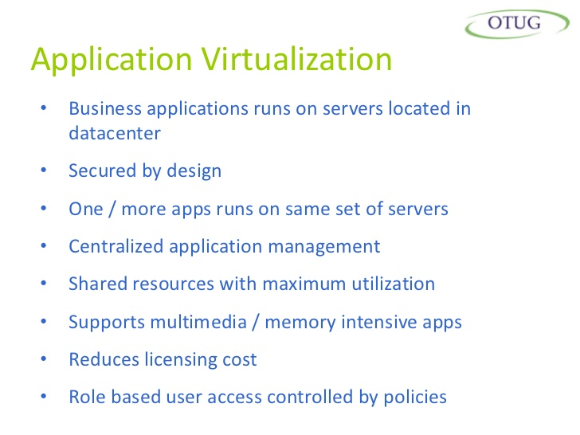

Slide 34
Application virtualization - Benefits
Applications delivered on-demand
No need to install and manage on every user desktop
Increased performance
Easily upgraded and deliver instantly
Published either locally installed or streamed to server
Offline access via streamed on client machines with help of offline plug-in
Role based application functionality
Multiple version of same application accessibility
Accessed via LAN, WAN, Internet & Mobile

Slide 35
Data Virtualiation
Data virtualization is a methodology that takes a layered approach to dealing with huge volumes of data from disparate ( different) sources

Slide 36
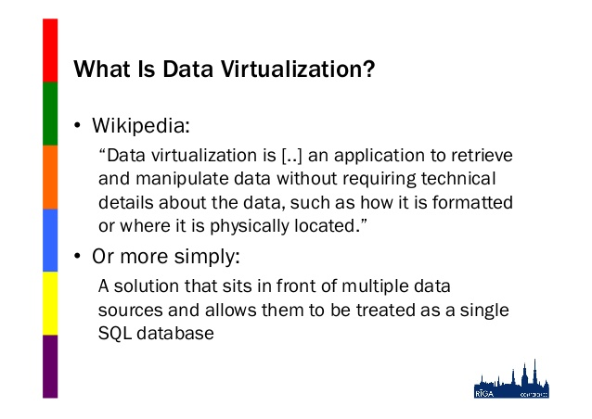

Slide 37
Implementation Levels of Virtualisation
Hardware
  Server / OS / Devices ( peripheral devices like printer etc..)
  Desktop ( similar to above)
  Storage ( Memory, hard disk etc..)
  Network
Application software
Data
FULL Virtualisation

Slide 38
CPU Virtualization -- a Server for Multiple Applications/OS
Application
Application
Application
Applications
Application
Applications
Operating
System
Operating
System
Operating
System
Operating
System
Operating
System
Operating
System
Hardware
Hypervisor
Hardware
Hypervisor is a software program that manages multiple operating systems (or multiple instances of the same operating system) on a single computer system.
The hypervisor manages the system's processor, memory, and other resources to allocate what each operating system requires.
Hypervisors are designed for a particular processor architecture and may also be called virtualization managers.

Slide 39
Memory Virtualization
Not only virtual memory
Hardware support
  e.g., x86 MMU and TLB
To run multiple virtual machines on a single system, another level of memory virtualization is required.
The VMM is responsible for mapping guest physical memory to the actual machine memory, and it uses shadow page tables to accelerate the mappings.
VM1
VM2
Process 1
Process 2
Process 1
Process 2
Virtual memory
Physical memory
Machine memory

Slide 40
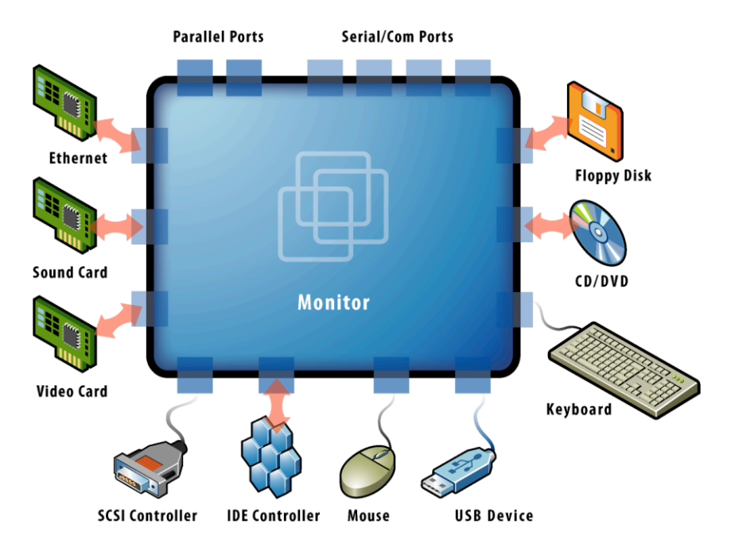
Device and I/O Virtualization
VMM ( Virtual Machine Monitor) supports all device/IO drivers
Physically/virtually existed

Slide 41
Tools for Virtualisation
Amazon EC2
VMware – vSphere
Nimbus
Open Nebula
Eucalyptus
O-virt

Slide 42
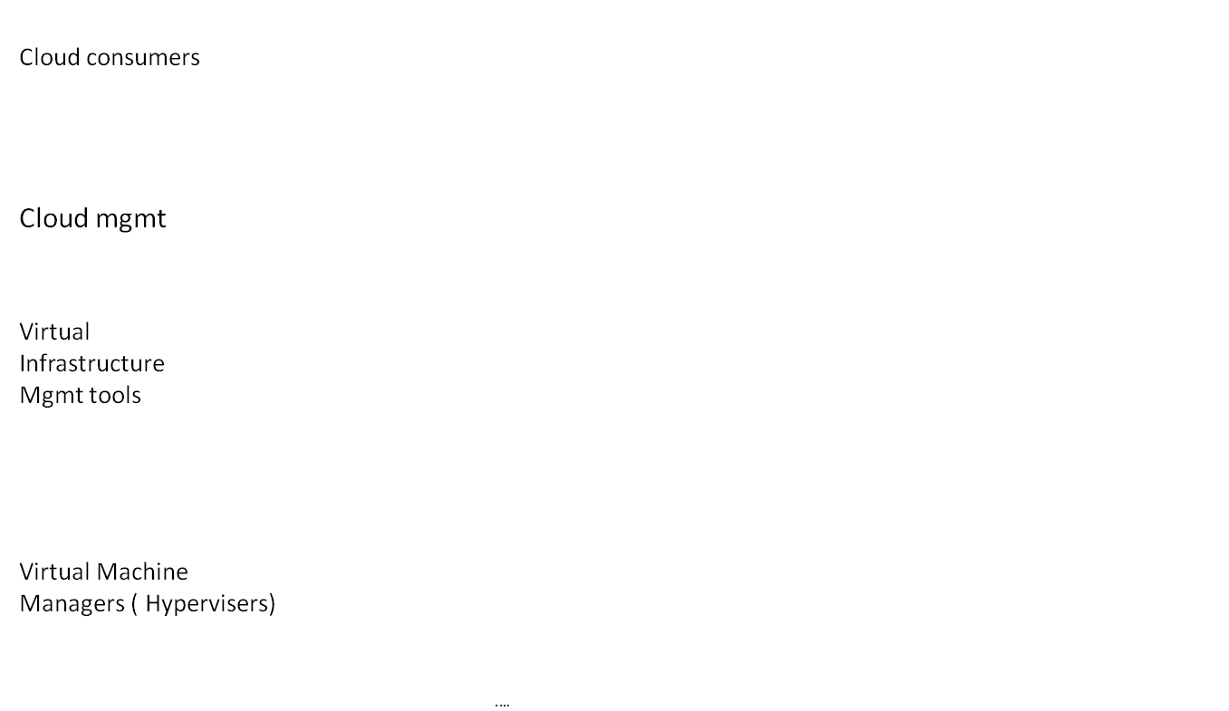
Tools Usage ( Cloud ecosystem – pvt cloud)
Cloud Interfaces ( Amazon EC2, Nimbus etc..)
Amazon EC2 and other Public Clouds
Eucalyptus
Nimbus
Open Nibula
VM ware
vSphere
VMware
Xen
KVM

Slide 43
Virtualization Structures/Tools and Mechanisms
Before virtualization, the operating system manages the hardware. After virtualization, a virtualization layer is inserted between the hardware and the OS. In such a case, the virtualization layer is responsible for converting portions of the real hardware into virtual hardware. Depending on the position of the virtualization layer, there are several classes of VM architectures, namely
1. Hypervisor architecture,
2. Paravirtualization
3. host based virtualization.

Slide 44
Hypervisor architecture,
Hypervisor and Xen Architecture Depending on the functionality, a hypervisor can assume a microkernel architecture or a monolithic hypervisor architecture.
A micro kernel hypervisor includes only the basic and unchanging functions (such as physical memory management and processor scheduling). The device drivers and other changeable components are outside the hypervisor.
A monolithic hypervisor implements all the aforementioned functions, including those of the device drivers. Therefore, the size of the hypervisor code of a micro kernel hypervisor is smaller than that of a monolithic hypervisor.

Slide 45
Xen Architecture
Xen Architecture Xen is an open source hypervisor program developed by Cambridge Unive rsity. Xen is a microkernel hypervisor, which separates the policy from the mechanism. It implements all the mechanisms, leaving the policy to be handled by Domain 0, as shown in Figure. Xen does not include any device drivers natively. It just provides a mechanism by which a guest OS can have direct access to the physical devices.

Slide 46
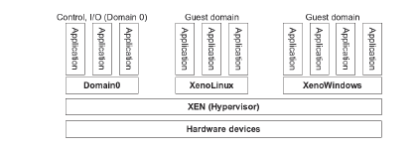
Xen Architecture

Slide 47
Xen Architecture
Like other virtualization systems, many guest Oses can run on top of the hypervisor. The guest OS (privileged guest OS), which has control ability, is called Domain 0, and the others are called Domain U. It is first loaded when Xen boots without any file system drivers being available. Domain 0 is designed to access hardware directly and manage devices.

